Slide 1
Brain Tumor Classification
Using Convolution Neural Network And Complex Valued-Convolution Neural Network
Presenter : Sathya Sudha Murugan
Supervisor : Soumick Chatterjee, M.Sc.

Slide 2
Agenda
Goal
Motivation
Related Work
Pseudo - Code
Experimental Setup
Data Collection
Data Pre-Processing
ANN vs CNN
Real Valued CNN Architecture
Complex Valued CNN Architecture
Results
Evaluation Metrics
Conclusion
Future Work
References

Slide 3

Goal
Brain Tumour Classification.
Implement :
Real Valued CNN : Magnitude
Complex Valued CNN : K-Space, Complex Image
Compare CNN and CV-CNN.
CNN
OR
CVCNN

Slide 4
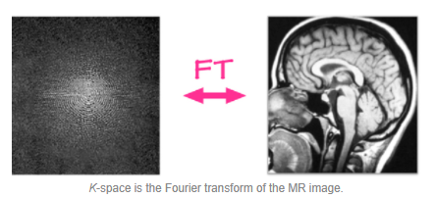
Motivation
Brain Tumor
Malignant and Benign
Primary and Secondary
State of Art : CT Scan, MRI, Angiography, Skull X-Rays, Biopsy, etc.
Advancement : Deep Learning - Image Classification - CNN MRI - Frequency Space - Complex Image - Real Image
Pre-Processing Time
Data Space - Augmentation - Better Accuracy

Slide 5
Related Work
3D convolutional layer to provide a detailed feature map that exploits the entire volumetric spatial information to incorporate both local and global contextual information.
A novel multi stream deep Convolutional Neural Network (CNN) architecture for glioma tumor grading/subcategory grading that captures and integrates data from different sensors.
Complex convolutions and current techniques for complex batch normalization, as well as complex weight initialization procedures for complex-valued neural nets.
To reconstruct undersampled MRI, ResNet was proposed to work directly in the k-space.

Slide 6
Pseudo - Code
Real Valued CNN
Data Collection
Data Preprocessing
Image Classification
Compare Results
Complex Valued CNN

Slide 7




Experimental Setup
24GB High RAM
GPU Accelerator - CUDA || CPU

Slide 8
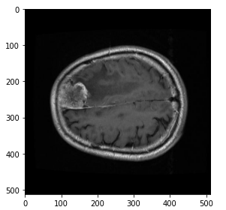
Data Collection
BRaTs - Brain Tumor Dataset
T1-weighted contrast-enhanced MRI images.
Types - Meningioma, Glioma, and Pituitary Tumor.
Label
MRI Image
PID
Image Data
Tumor Border
Tumor Mask

Slide 9
Data Preprocessing
Numpy Arrays PyTorch Tensors Normalization
Data Augmentation - Memory
K_Space
Complex Image
Real Image
Fourier Transformation
Compute Absolute Value

Slide 10
ANN vs CNN
Artificial Neural Network
Neurons and Weights
Universal Function Approximation
1D Input Size of image Trainable Parameters Spatial Features
Convolution Neural Network
Convolution Layers
Automatic Kernel Learning Feature Map
2D or 3D Input Trainable Parameters No loss of Spatial features

Slide 11
Real Valued CNN Architecture
Input
Batch Normalization
(64)
Convolution
(3,64,5,1)
Convolution
(3,64,5,1)
Fully Connected Layer
(25000,1000)
Fully Connected Layer
(1000,100)

Slide 12
Complex Valued CNN Architecture
Convolution_
Imaginary
(3,64,5,1)
Convolution_
Imaginary
(3,64,5,1)
Input
Batch Normalization
(64)
Fully Connected Layer
(25000,1000)
Fully Connected Layer
(1000,100)
Convolution_
Real
(3,64,5,1)
Convolution_
Real
(3,64,5,1)

Slide 13
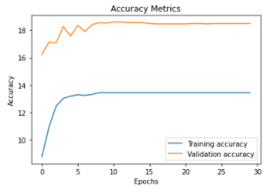
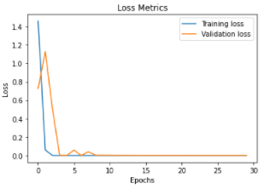
Results
Training vs Validation in Real Valued CNN

Slide 14
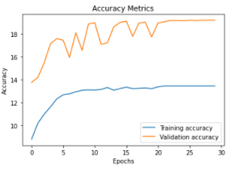
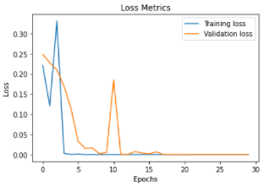
Results
Training vs Validation in CV-CNN using K-Space

Slide 15
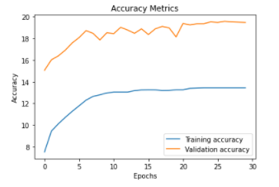
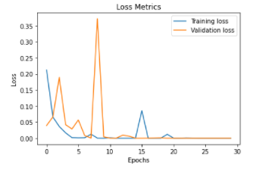
Results
Training vs Validation in CV-CNN using Complex Image

Slide 16
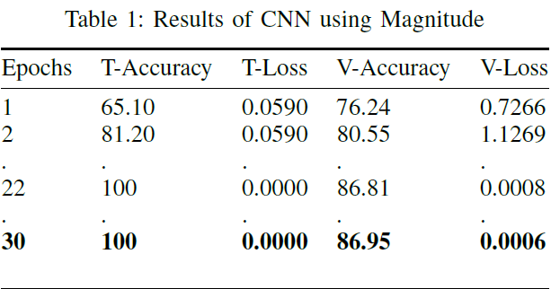
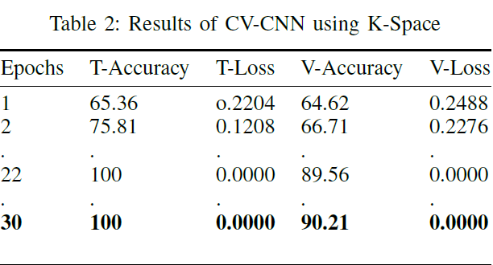
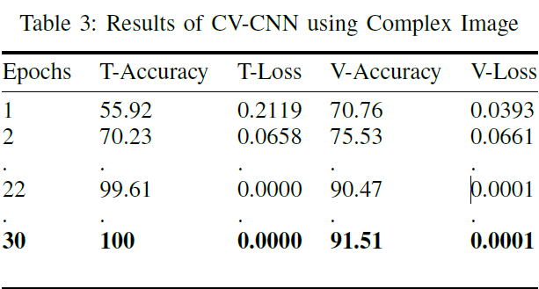
Evaluation Metrics

Slide 17
Conclusion
The CNN consumes less training time with reduced memory due to its simple architecture.
However, The Complex Valued CNN performs better than Real Valued CNN in terms of accuracy and loss metrics.
As shown in the results, the validation accuracy at the last epoch is around 90 with loss of 0.0001 for both the CVCNN.
Whereas, the CNN has an accuracy of 86.95 with loss of 0.0006 at the last epoch.
Therefore, CV-CNN outperforms CNN in terms of accuracy and loss metrics.

Slide 18
Future Work
Compare CNN and CV-CNN of various architectures.
Double the real valued CNN features equivalent to CV-CNN.
Implement the real valued CNN with existing pre-trained CNN’s
Then build the same architecture for CV-CNN.

Slide 19
References
H. Mzoughi, I. Njeh, A. Wali, M. B. Slima, A. BenHamida, C. Mhiri, and K. B. Mahfoudhe, “Deep Multi-Scale 3D Convolutional Neural Network (CNN) for MRI Gliomas Brain Tumor Classification,” Journal of Digital Imaging, vol. 33, no. 4, pp. 903–915, 2020.
C. Ge, I. Y. H. Gu, A. S. Jakola, and J. Yang, “Deep Learning and Multi-Sensor Fusion for Glioma Classification Using Multistream 2D Convolutional Networks,” Conference proceedings : ... Annual International Conference of the IEEE Engineering in Medicine and Biology Society. IEEE Engineering in Medicine and Biology Society Annual Conference, vol. 2018, pp. 5894–5897, 2018.
M. Amian and M. Soltaninejad, Multi-resolution 3d cnn for mri brain tumor segmentation and survival prediction, 2020, vol. 11992 LNCS.
C. Trabelsi, O. Bilaniuk, Y. Zhang, D. Serdyuk, S. Subramanian, J. F. Santos, S. Mehri, N. Rostamzadeh, Y. Bengio, and C. J. Pal,“Deep complex networks,” 6th International Conference on Learning Representations, ICLR 2018 - Conference Track Proceedings, no. 2016, pp. 1–19, 2018.
S. Chatterjee, C. Sarasaen, A. Sciarra, and M. Breitkopf, “Going beyond the image space : undersampled MRI reconstruction directly in the k-space using a complex valued residual neural network Going beyond the image space : undersampled MRI reconstruction directly in the k-space using a complex valued residual neural network,” no. March, 2021.
M. Wilmanski, C. Kreucher, A. Hero, S. S. St, and A. Arbor, “The University of Michigan Integrity Applications Incorporated,” pp. 1–5.

Slide 20
Thank You

